Slide 1
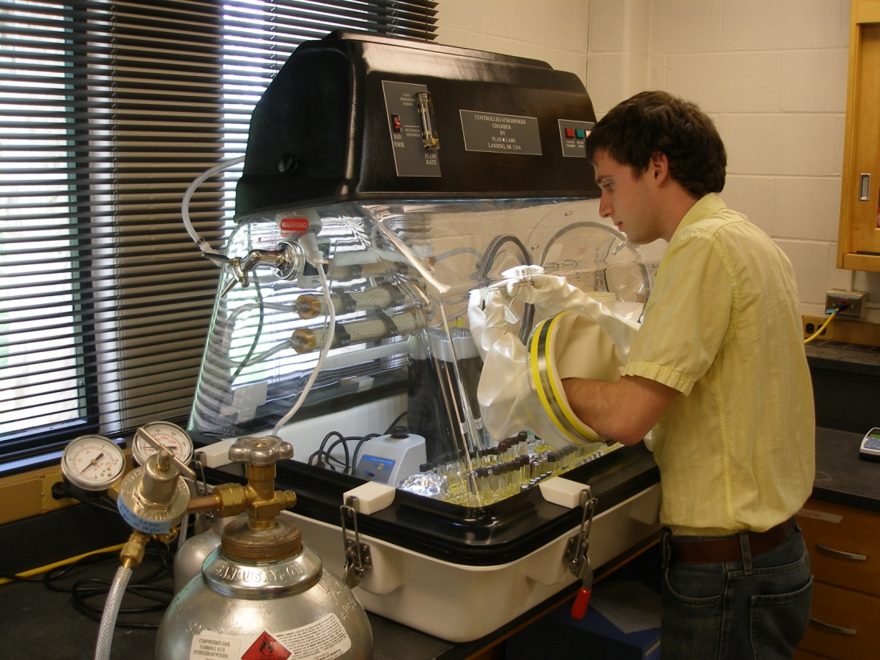
pH Regulation Differs Under Low Oxygen Conditions in E. Coli
Daniel P. Riggins, Keith Martinez, and Joan L. Slonczewski
Department of Biology, Kenyon College, Summer Science 2011
Abstract
The ability of E. coli to survive extreme-acid exposure has been studied mainly in the presence of oxygen. In the human digestive tract, the stomach (pH 2-4) provides some oxygen, but the colon (pH 5-9)—where E. coli resides—is largely anoxic. Certain mechanisms for maintaining cytoplasmic pH, such as proton consumption by hydrogenase-3, are unique to low-oxygen conditions. We investigated the role in extreme-acid survival of regulators ArcA and FNR, which transition E. coli to anaerobic metabolism. We also tested the role of the Gad regulon, which aerated cultures require for extreme-acid survival. Anoxic conditions (≤ 1 ppm oxygen) were established using a sealed glove box (PlasLabs). When conditions were anoxic, the fnr mutant grew ten times more colonies after exposure to extreme-acid than did the wild-type or arcA mutant. Different stages of the experiment were conducted under conditions defined as oxic (aerated cultures, performed outside the chamber) or anoxic (performed inside the chamber). Both culture growth and extreme acid-exposure had to be anoxic for fnr strains to show increased survival at pH 2.5. Using qRT-PCR it was determined that the fnr mutant expresses the FNR-repressed acid resistance genes cfa, gadB, and hdeA at a relatively higher rate than the wild-type. However, a gadC mutant showed high acid resistance. Thus the Gad acid resistance system is not needed in low oxygen (< 1 ppm). A hyc (hydrogenase 3) mutant failed to survive acid, consistent with previous work showing that hydrogenase proton consumption enables anoxic extreme-acid survival. The effect of FNR was eliminated in acid-exposure medium lacking the tryptone component of LBK.
FNR-Associated Acid Sensitivity is Observed Only in the Presence of LBK Components
Conclusions
Δfnr Mutation Enhances Extreme-Acid Survival Under Anoxia When the assay is run under anoxic conditions we see that the survival of the wild-type and ΔarcA drops dramatically while that of Δfnr is largely unaffected. This is the result we expect. FNR is the predominate regulator in conditions established by the anoxic chamber (< 5 ppm O₂). ΔarcA is more dominant under microaerobic conditions (Sawers 1999).
FNR Represses Transcription of Key Acid-Response Genes The genes cfa, gadB, and hdeA are important for an effective acid-survival response. By repressing these proteins under anoxia, FNR potentially decreases the ability of E. coli to survive acid-shock.
Tryptone Mediates FNR-Associated Acid Sensitivity Strains with active FNR proteins are only sensitive to low pH when complex media components like tryptone are present. Tryptone consists of digested peptides which may be fermented into weak acids. It is possible tryptone may also contribute to oxidative stress. (De Spiegeleer et al. 2004).
Growth and Exposure are the Key Stages for Establishing an FNR-Associated Acid Senstivity Phenotype It is not necessary to dilute or plate E. coli anoxically in order to observe the anoxic-enhanced extreme-acid survival phenotype. Indeed, dilution and plating shouldn’t have an effect as they are simply steps that make it possible to observe the effects of a treatment that has already been imposed, that is, exposure to extreme pH.
Anoxic Conditions Necessitate Alternative Acid-Response Strategies While the Gad system is required for acid survival under aerated conditions (Hersh et al. 1996), it does not affect the acid response under anoxia. Consistent with the results of Noguchi et al. (2010), hydrogenase-3 does contribute to survival under anoxic extreme-acid exposure .
Exposure = pH 2.5
Error = SEM
Growth and Exposure are the Key Stages for Establishing FNR-Associated Acid Sensitivity
Null Mutation for fnr Enhances Extreme-Acid Survival Under Anoxia
(Kang 2004)
FNR
Induce
Reactive Oxygen Detox
Anaerobic Respiration (frdB)
Fermentation
Monomers
O₂
Dimer
O₂
Repress
TCA Cycle (sdhC)
Aerobic Respiration
Acid-Response (cfa, gadB, and hdeA)
Exposure = pH 2.5
Error = SEM
O₂ = Aerated; O₂ < 5 ppm
Acknowledgements
I would like to thank Dr. Joan Slonczewski for her kind mentorship and guidance throughout this project. Also, much thanks to Keith Martinez and Ryan Kitko for assistance on experiments. Additional thanks to the Keio collection for providing mutant strains. Finally, this project was funded by means of a Kenyon College Summer Science Fellowship and NSF Grant MCB-1050080.
Error = SEM
Stage 1 – Stage 2 – Stage 3 – Stage 4
Growth – Exposure – Dilution – Plating
FNR Represses Transcription of Key Acid-Response Genes
HycE Contributes to Anoxic Acid Resistance But GadC Does Not
References
De Spiegeleer, P., J. Sermon, A. Lietaert, A. Aertsen, C. W. Michiels. 2004. Source of tryptone in growth medium affects oxidative stress resistance in Escherichia coli. J. Appl. Microbiol. 97 (1): 124-133.
Hersh, B. M., F. T. Farooq, D. N. Barstad, D. L. Blankenhorn and J. L. Slonczewski. 1996. A glutamate-dependent acid resistance gene in Escherichia coli. J. Bacteriol. 178 (13): 3978-3981.
Kang, Y., K. D. Weber, Y. Qiu, P. J. Kiley, and F. R. Blattner. 2004. Genome-Wide Expression Analysis Indicates that FNR of Escherichia coli K-12 Regulates a Large Number of Genes of Unknown Function. J. Bacteriol. 187 (3): 1135-1160.
Sawers, Gary. 1999. The aerobic/anaerobic interface. Current Opinion in Microbiology. 2: 181-187.
Error= SEM
Percent survival is
the ratio of:
The number of colonies grown on a plate from a culture exposed to extreme pH for 2 hours.
Exposure = pH 2.5
Error = SEM
The number of colonies grown on a plate from a control culture diluted to the same degree.

